Slide 1
UNIT 1 - INTRODUCTION TO ENERGY CONSERVATION
By
Dr. N. Dilip Raja

Slide 2
ENERGY
Define energy
Biologically - “The strength required to sustain physical activity” – Energy is associated with vitality “state of being strong and active”.
Technically – “power derived from a source for suitable application” – source is the transmitter – application is the receiver.
Law of conservation of energy “It can neither be created nor be destroyed, but can be transformed from one form to the other”
Different forms of energy – sound, light, heat, physical (work, kinetic, potential), electricity, magnet, chemical (fuels, reaction), nuclear(fission and fusion).

Slide 3
ENERGY (contd…)
Symbol: E
Units – Joule, kW⋅h, BTU, calorie, eV, erg (ergon = 100 nJ), foot-pound
J = kg m² / s²
Energy | Power
Energy is the ability to create a change, for example, creating motion. | Power - how fast energy is used or transmitted - = amount of energy /time it took to use the energy.
Tasks (like lifting a box) require an amount of energy to complete. A battery will hold a particular amount of energy; a given amount of fuel, like food. | A circular saw will draw a certain amount of power to run, and how quickly power is drawn from a battery determines how long its stored energy will last.
Unit is joule | Unit is J/s = W

Slide 4
PAST AND PRESENT ENERGY SCENARIO
Energy - one of the major inputs - for the economic development of any country.
In the case of the developing countries - energy sector assumes a critical importance in view of the ever increasing energy needs - requiring huge investments to meet them.
Energy can be classified into several types based on the following criteria:
Primary and Secondary energy
Commercial and Non commercial energy
Renewable and Non-Renewable energy

Slide 5
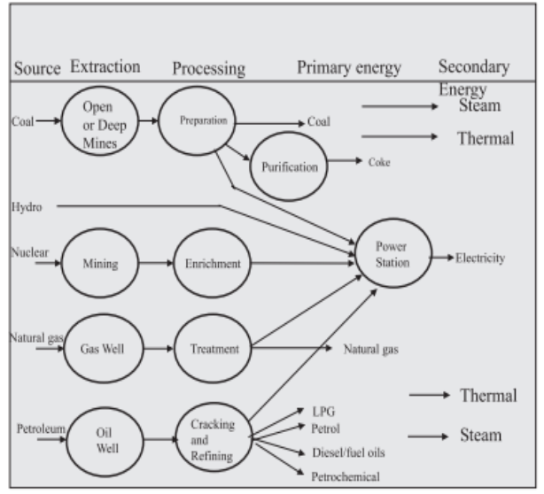
PRIMARY AND SECONDARY ENERGY

Slide 6
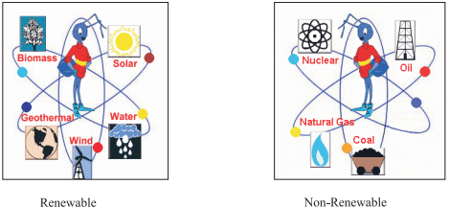
COMMERCIAL AND NON- COMMERCIAL ENERGY
Commercial - Electricity, lignite, coal, oil, natural gas etc.
Non- commercial - Firewood, agro waste in rural areas; solar energy for water heating, electricity generation, for drying grain, fish and fruits; animal power for transport, threshing, lifting water for irrigation, crushing sugarcane; wind energy for lifting water and electricity generation.
RENEWABLE AND NON- RENEWABLE ENERGY

Slide 7
WORLD ENERGY CONSUMPTION
Total energy produced and used by the entire human civilization.
Measured per year – unit is TWh/y
All energy harnessed from every energy sources for the purpose of industrial and technological uses are considered
It has deep implications for humanity's socio-economic-political sphere
World energy consumption is recorded and published periodically by
International Energy Agency (IEA),
Energy Information Administration (EIA), US
European Environment Agency (EEA)
Improved data and understanding of world energy consumption - reveal systemic trends and patterns - help frame current energy issues -encourage movement towards collectively useful solutions.

Slide 8
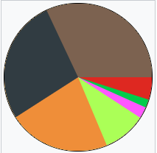
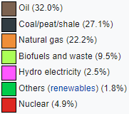
WORLD ENERGY CONSUMPTION 2017

Slide 9
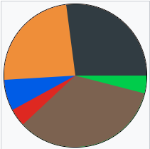
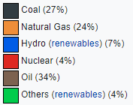
WORLD ENERGY CONSUMPTION 2018

Slide 10
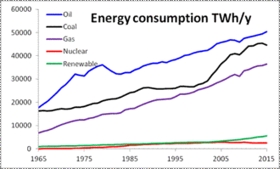
YEARLY WORLD ENERGY CONSUMPTION

Slide 11
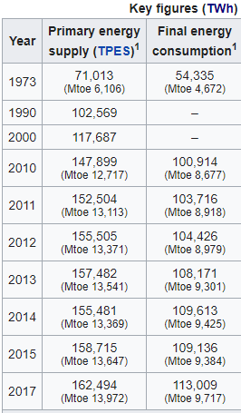

WORLD ENERGY CONSUMPTION - ELECTRICITY

Slide 12
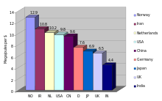
Energy intensity of different economies
The graph shows the ratio between energy usage and GDP for selected countries. GDP is based on 2004 purchasing power parity and 2000 dollars adjusted for inflation

Slide 13
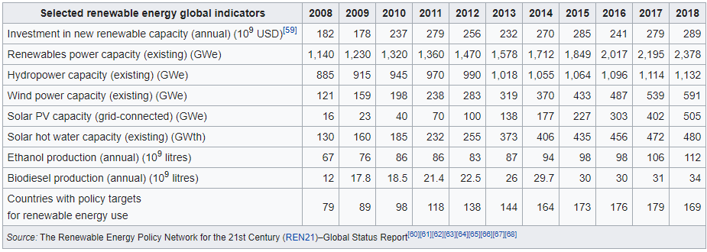

Slide 14
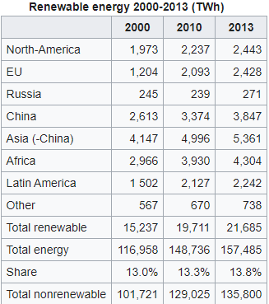

Slide 15
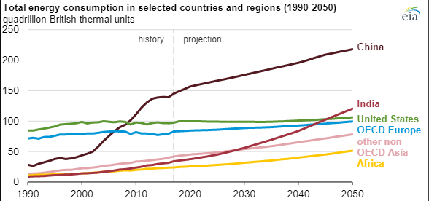

Slide 16
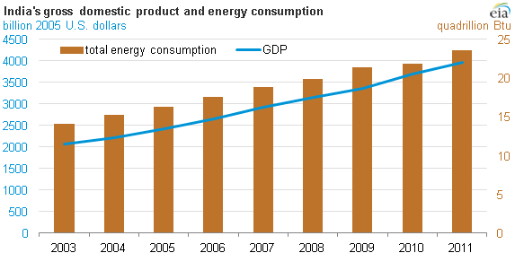

Slide 17
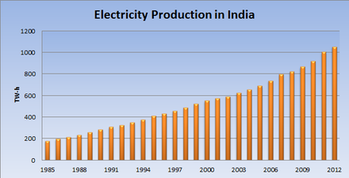

Slide 18
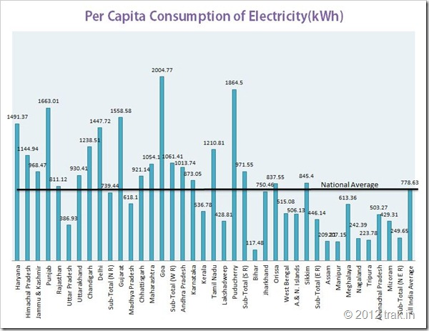

Slide 19
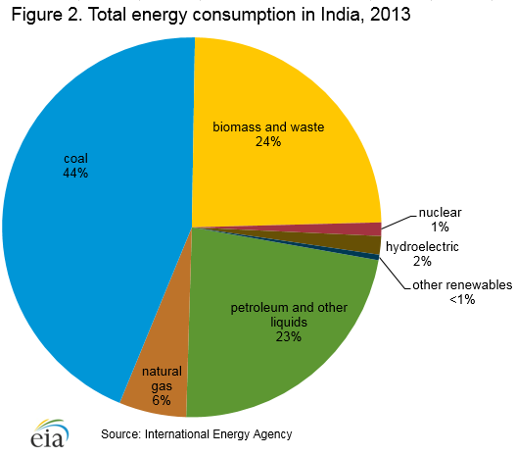

Slide 20
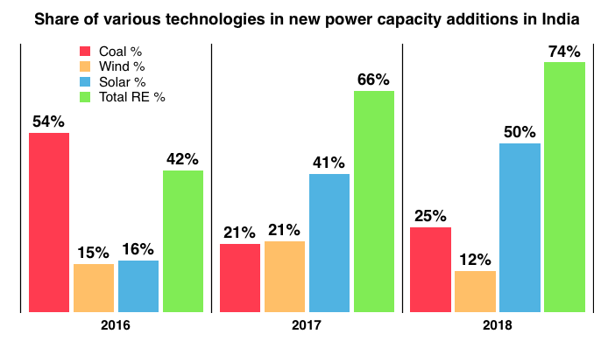

Slide 21
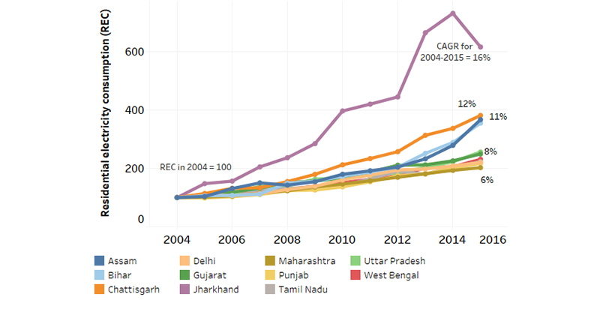
RESIDENTIAL ELECTRICITY CONSUMPTION - INDIA

Slide 22
IMPORTANT MEANINGS
Define resource – “A stock or supply of money, materials, staff, and other assets that can be drawn on by a person or organization in order to function effectively”.
Energy resource – Indicates the availability of fuels and other sources to aid in the functioning of a society, industry or an individual.
Paradigm - A typical example or pattern of something; a pattern or model. “ A very clear and typical example of something”.

Slide 23
RESOURCE AVAILABILITY
The future availability of natural resources – defined here as food, water, energy, and minerals – is critically important.
Perspectives on future resource availability - highly contested, mostly because natural resource
A more integrated, future-oriented view can shift the debate beyond a simplistic and polarized scarcity/abundance debate
Allow experts and decisionmakers to find dispassionate common grounde supply
Four distinct sets of perceptions (paradigms) of natural resource availability - demand are hard to predict and complex in nature
Threats of material exhaustion
Concern about rising costs
Long-term abundance
Social injustice focused on distributional challenges

Slide 24
Three relevant and demanding narratives for the times ahead
Clash of interests: A world where resource scarcity plays out because of pre-emptive geopolitical measures taken by countries acting on psychological fears. Market deficiencies appear as the world’s geo-economic commons are divided into myriad competing channels of exchange.
Alarming abundance: Apparent benefits of plentiful fossil and renewable energy risk being overshadowed in this world by their impact on associated resources such as water, and by their social and environmental consequences.
Challenge of transition: World, governments, consumers and companies realize and accept the full costs of their transition to a low-carbon, durable and sustainably sourced economy. They suffer through what they perceive as a change in their use of natural resources

Slide 25
Four distinct sets of perceptions (paradigms)
Natural resource availability - demand are hard to predict - complex in nature
Threats of material exhaustion
Concern about rising costs
Long-term abundance
Social injustice focused on distributional challenges

Slide 26
Five cross-cutting and important insights
The role of technology, preferences, policies and prices is underestimated when forecasting supply and demand for natural resources.
Contrary to popular perceptions, population growth is and will be far less significant in spurring resource demand than economic growth and development in the period to 2035.
Physical, economic, political and social interconnections between resources are growing, and will increasingly influence resource availability, in both positive and negative ways.
Defining natural resource availability often fails to consider how they are distributed, both between countries and between individuals within countries.
Environmental factors create local and global risks to resource availability, while resource production and use are the primary factors in environmental risks.

Slide 27
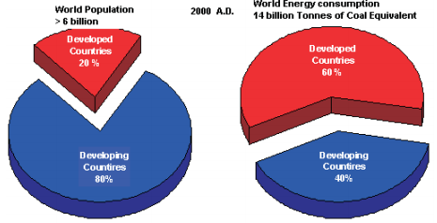
DEMAND SUPPLY GAP

Slide 28
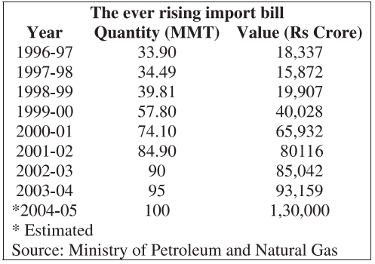
DEMAND SUPPLY GAP
Oil accounts for about 36 % of India's total energy consumption.
India today - one of the top ten oil-guzzling nations in the world - soon overtake Korea as third largest consumer of oil in Asia after China and Japan.

Slide 29
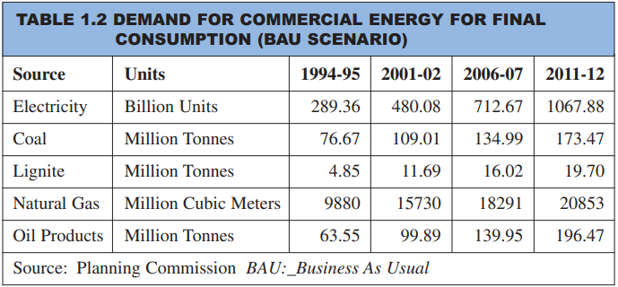
DEMAND SUPPLY GAP

Slide 30
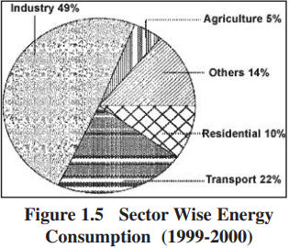
DEMAND SUPPLY GAP

Slide 31
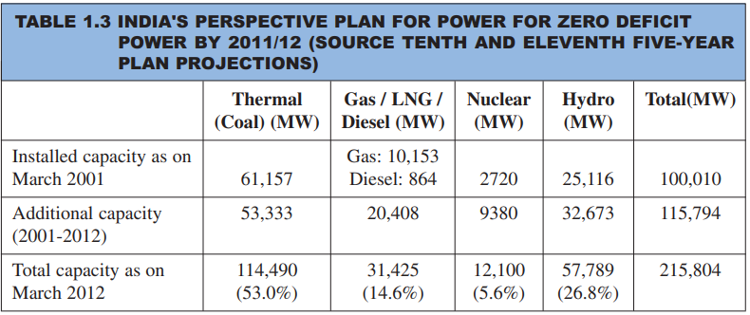
DEMAND SUPPLY GAP

Slide 32

ENERGY CONSERVATION ACT
Bureau of Energy Efficiency, India | BEE
Formation | 1 March 2002; 18 years ago
Type | Autonomous Government Agency
Legal status | Constituted by Energy Conservation Act, 2001.
Purpose | Development of policies and strategies, with an emphasis on self-regulation and market principles under the Energy Conservation Act, 2001.
Headquarters | SEWA Bhavan
Location | R. K.Puram, New Delhi - 110066
Region served | India
Official language | Hindi English
Parent organisation | Ministry of Power

Slide 33
OBJECTIVES OF BEE
To exert leadership and provide policy recommendation and direction to national energy conservation and efficiency efforts and programs.
To coordinate energy efficiency and conservation policies and programs and take it to the stakeholders
To establish systems and procedures to measure, monitor and verify energy efficiency results in individual sectors as well as at a macro level.
To leverage multi-lateral and bi-lateral and private sector support in implementation of Energy Conservation Act and efficient use of energy and its conservation programs.
To demonstrate delivery of energy efficiency services as mandated in the EC bill through private-public partnerships.
To interpret, plan and manage energy conservation programs as envisaged in the Energy Conservation Act.

Slide 34
ACTIVITIES OF BEE
Provide a policy recommendation and direction to national energy conservation activities
Coordinate policies and programmes on efficient use of energy with shareholders
Establish systems and procedures to verify, measure and monitor Energy Efficiency (EE) improvements
Leverage multilateral, bilateral and private sector support to implement the EC Act '01
Demonstrate EE delivery systems through public-private partnerships

Slide 35
STNADARDS AND LABELING
The scheme was launched by the Hon'ble Minister of Power in May,2006 and is currently invoked for electrically operated equipments/appliances.
The Objectives of Standards & Labeling Program is to provide the consumer an informed choice about the energy saving and thereby the cost saving potential of the marketed household and other equipment.
This is expected to impact the energy savings in the medium and long run while at the same time it will position domestic industry to compete in such markets where norms for energy efficiency are mandatory

Slide 36
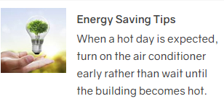

TYPICAL EXAMPLES

Slide 37
STNADARDS AND LABELING PROGRAMME
Scheme is invoked for 21 equipment/appliances including 10 for which it is mandatory.
Other appliances are presently under voluntary labeling phase.
Estimated savings from these labeling programmes have been about 12000 MW since 2007.

Slide 38
Products notified under mandatory appliance
Frost Free (No-Frost) Refrigerator
Tubular Fluorescent Lamps
Room Air Conditioners
Distribution Transformers
Room Air Conditioners (Cassette, Floor Standing Tower, Ceiling, Corner AC)
Direct Cool Refrigerator
Electric Geysers
Color TV
Room Air Conditioners (Inverter type)
LED lamps

Slide 39
Products under voluntary labelling
Induction Motors
Pump sets
Ceiling fans
Liquefied Petroleum Gas (LPG) Stoves
Washing machine
Computer (Notebook/Laptops)
Ballast (Electronic/Magnetic)
Office equipment's (Printer, Copier, Scanner, MFD's)
Diesel Engine Driven Monoset Pumps for Agricultural Purposes
Solid State Inventor
Diesel Generator
Chillers
Microwave Ovens
Deep Freezers
Light Commercial Air Conditioners (LCAC)

